Slide 1
1. Relational expressions (intro) 2. If-else

Slide 2
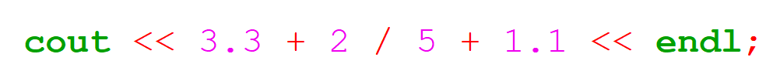
Review Question.
What is the output of the following?

Slide 3

Style Guide
Throughout the year I’ll include tips for writing more elegant code.
How can we make the following line more concise?
Notes:
Cout << “Hello World\n”;

Slide 4
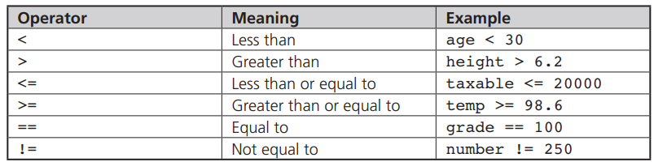
Relational Expressions
- allow us to compare two values

Slide 5
Logical Operators
- Allow us to combine simple relational expressions into more complex conditions.
Logical Operator | Operator Symbol | Example
AND | && | (x > 0) && (x < 5)
OR | || | (x < 0) || (x > 5)
NOT | ! | Will explain in class.

Slide 6
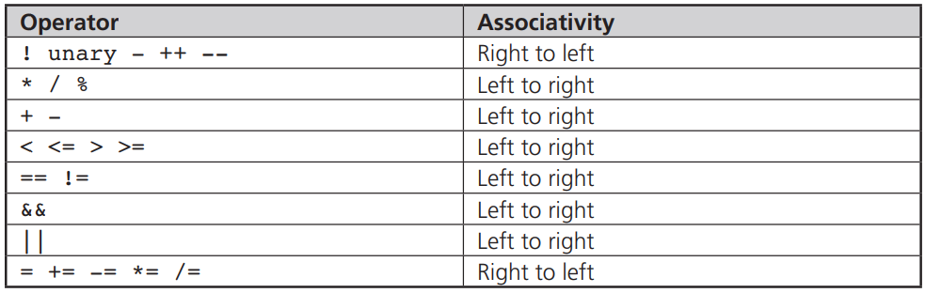
Operator Precedence (BEDMAS++)
I’m including this for your reference.
To be safe use brackets to group logical expressions and you shouldn’t run into any issues.

Slide 7
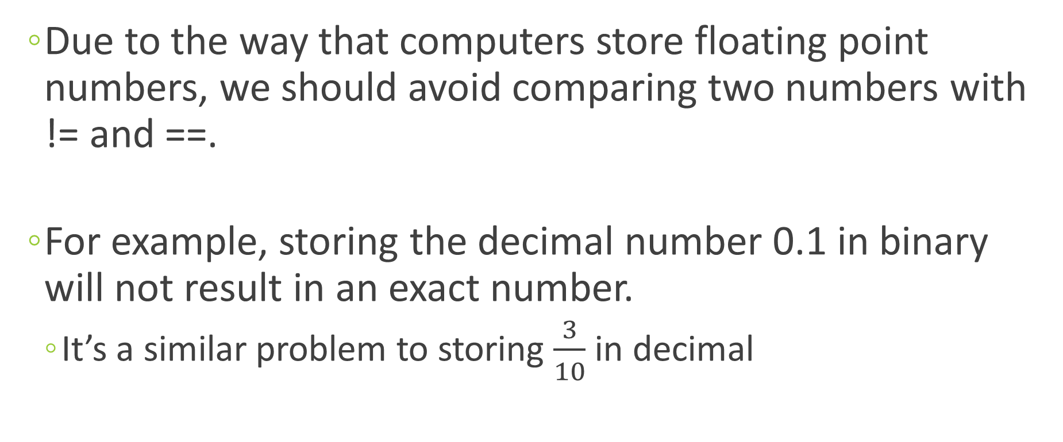
Numerical Accuracy Problem
Due to the way that computers store floating point numbers, we should avoid comparing two numbers with != and ==.
For example, storing the decimal number 0.1 in binary will not result in an exact number.
It’s a similar problem to storing $\frac{3}{10}$ in decimal

Slide 8
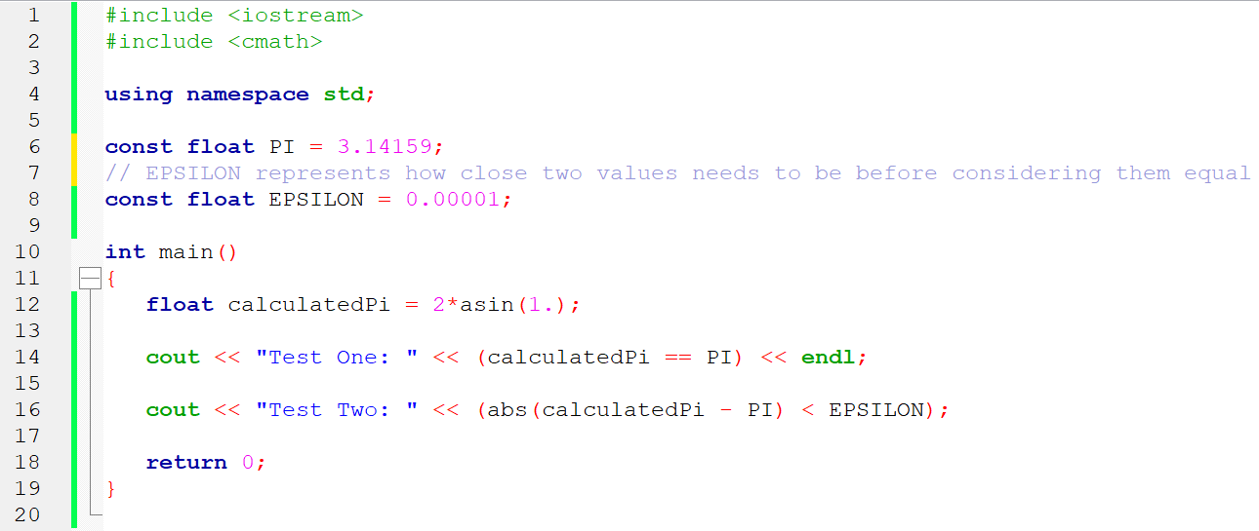
How do we solve this problem?

Slide 9
The if-else Statement
The if-else statement directs the computer to select between two statements (paths) based on the result of a comparison.
if (expression) statement1;
else statement2;

Slide 10
If-else flowchart
is condition
true?
True
False
Statement 1
Statement 2
Next Statement

Slide 11
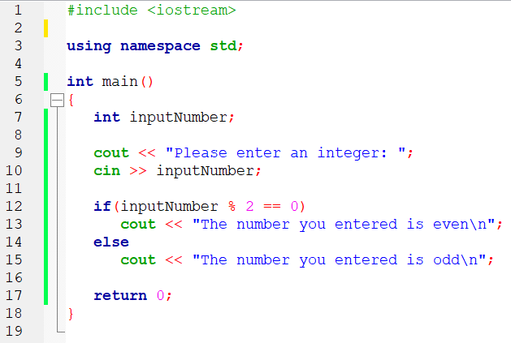
First Example

Slide 12
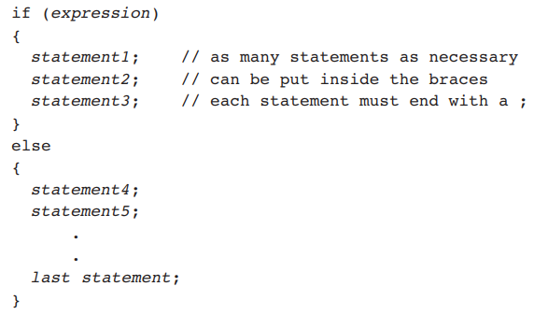
Compound Statements
We can do multiple statements for the if and/or the else part by enclosing them in curly brackets (aka braces):

Slide 13
Omitting the else part
This is perfectly acceptable:
if (expression)
statement1;

Slide 14
One-way selection flowchart
is condition
true?
True
Statement 1
False
Next Statement

Slide 15
Common Mistake!!!
What’s wrong with this code?
if(x = 13) cout << “Some text\n”; else cout << “Some other text\n”;

Slide 16
Exercise 1:
Write a C++ program that asks the user to input two different integers (assume the user enters this correctly). If the first number entered is greater than the second number, the program should print the message
“The first number is greater.”
Otherwise, it should print the message:
“The first number is smaller.”

Slide 17
Exercise 2:
Years that are evenly divisible by 400 or are evenly divisible by 4 but not by 100 are leap years.
For example, because 1600 is evenly divisible by 400, 1600 was a leap year.
Similarly, because 1988 is evenly divisible by 4 but not by 100, it was also a leap year.
Using this information, write a C++ program that accepts the year as user input, determines whether the year is a leap year, and displays a message telling the user whether the entered year is or is not a leap year.
Test and verify your solution using an online calendar.

Slide 18
Exercise 3 – Part A
Write, compile, and run a C++ program to compute and display a person’s weekly salary as determined by the following conditions:
If the hours worked are less than or equal to 40, the person receives $12.00 per hour;
otherwise, the person receives $480.00 plus $18.00 for each hour worked over 40 hours.
The program should request the hours worked as input and display the salary as output.

Slide 19
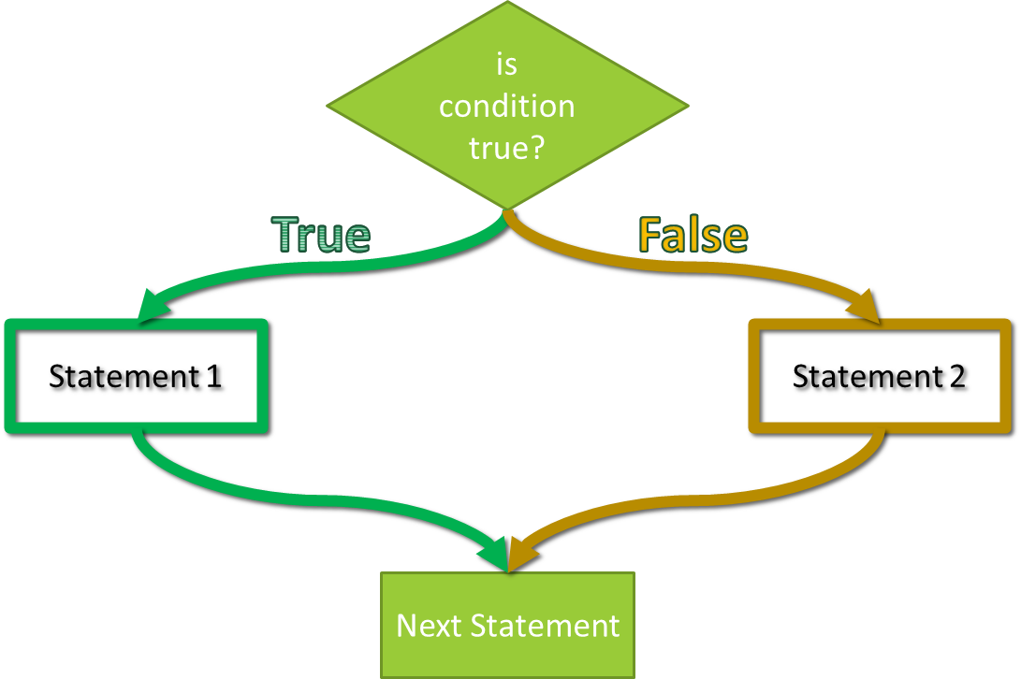
Exercise 3 – Part B
Test each possible path of your program with a different test value.
How many values did you need to choose?
How did you choose the values?

Slide 20
This weekend
Look at the solutions for last class (on Schoology)
Read this PowerPoint
Go through the exercises (no submission required)
I’ll post the solutions next class so you can check

